Slide 1

ARCHITECTURE DESIGN
FOREIGN DIRECT INVESTMENT ANALYSIS
Last Date of Revision – 18-06-2024
Created by : Rishi Kalpa Mukherjee

Slide 2
DOCUMENT CONTROL
Date | Version | Description | Author
26-05-2024 | 1.0 | Introduction, Architecture and Deployment | Rishi Kalpa Mukherjee
18-06-2024 | 1.1 | Final Revision and Version of Architecture | Rishi Kalpa Mukherjee

Slide 3
CONTENTS
Document Version Control........................................................................................................2
1. Introduction......................................................................................................................4
1.1 What is Architecture Design Document? ..............................................................................4
1.2 Scope…......................................................................................................................4
2. Architecture…....................................................................................................................5
2.1 Tableau Architecture .....................................................................................................5
2.2 Tableau Server Architecture ............................................................................................6
2.3 Tableau Server Processes ................................................................................................7
3. Deployment Description.........................................................................................................9
3.1 Deployment options .......................................................................................................9

Slide 4
Introduction
1.1 What is Architecture design document?
Any software needs the architectural design to represents the design of software. IEEE defines architectural design as “the process of defining a collection of hardware and software components and their interfaces to establish the framework for the development of a computer system.” The software that is built for computer-based systems can exhibit one of these many architectures.
Each style will describe a system category that consists of :
A set of components (example: a database, computational modules) that will perform a function required by the system.
The set of connectors will help in coordination, communication, and cooperation between the components.
Conditions that how components can be integrated to form the system.
Semantic models that help the designer to understand the overall properties of the system.
1.2 Scope
Architecture Design Document (ADD) is an architecture design process that follows a step-by-step refinement process. The process can be used for designing data structures, required software architecture, source code and ultimately, performance algorithms. Overall, the design principles may be defined during requirement analysis and then refined during architectural design work.

Slide 5
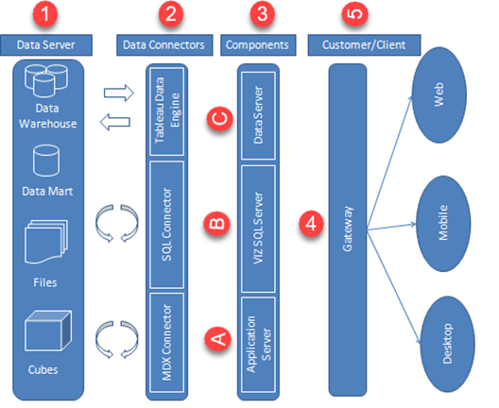
2.1 Architecture

Slide 6
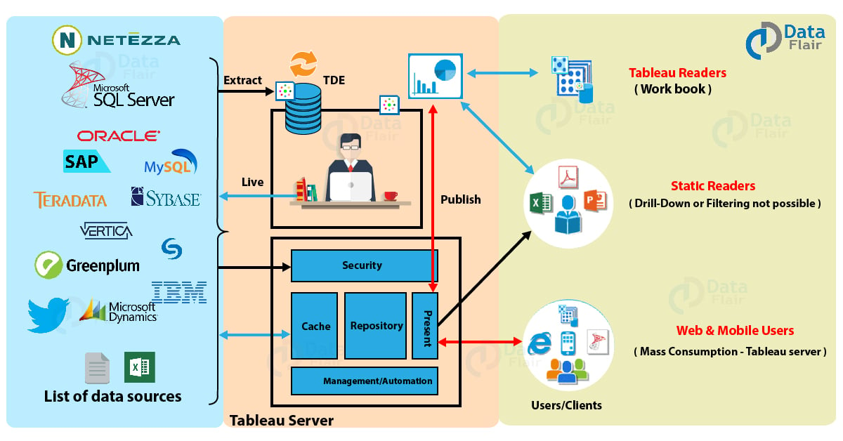
2.2 Tableau Server Architecture
Tableau has a highly scalable, n-tier client-server architecture that serves mobile clients, web clients and desktop-installed software. Tableau Server architecture supports fast and flexible deployments. Tableau Server is developed to connect various data tiers. It connects clients from the web, Desktop, and Mobile. Tableau Desktop is a strong data visualization tool. It is highly available and secure. It works on both virtual machines and physical machines. It is a multi-user, multi-threaded, and multi-process system.

Slide 7
2.3 Tableau Server Processes
2.3.1. Gateway/Load Balancer:
It acts as an Entry gate to the Tableau Server and also balances the load to the Server if multiple Processes are configured.
2.3.2. Application Server:
Application Server processes (wgserver.exe) handle browsing and permissions for the Tableau Server web and mobile interfaces. When a user opens a view in a client device, that user starts a session on Tableau Server. This means that an Application Server thread starts and checks the permissions for that user and that view.
2.3.3. Repository:
Tableau Server Repository is a PostgreSQL database that stores server data. This data includes information about Tableau Server users, groups and group assignments, permissions, projects, data sources, and extract metadata and refresh information.
2.3.4. VIZQL Server:
Once a view is opened, the client sends a request to the VizQL process (vizqlserver.exe). The VIZQL process then sends queries directly to the data source, returning a result set that is rendered as images and presented to the user. Each VIZQL Server has its own cache that can be shared across multiple users.
2.3.5. Data Engine:
It Stores data extracts and answers queries.
2.3.6 Data Server:
Data Server Manages connections to Tableau Server data sources. It also maintains metadata from Tableau Desktop, such as calculations, definitions, and groups.

Slide 8
2.3.7 Backgrounder:
The backgrounder Executes server tasks which includes refreshes scheduled extracts, tasks initiated from tabcmd and manages other background tasks.

Slide 9
3. Deployment Description
3.1 Deployment options in Tableau
Tableau’s analytics platform offers three different deployment options depending on your environment and needs. The below graphic shows each option at a glance:
3.1.1. Tableau Online Get up and running quickly with no hardware required. Tableau Online is fully hosted by Tableau so all upgrades and maintenance are automatically managed for you.
3.1.2. Tableau Server deployed on public cloud: Leverage the flexibility and scalability of cloud infrastructure without giving up control. Deploy to Amazon Web Services, Google Cloud Platform, or Microsoft Azure infrastructure to quickly get started with Tableau Server (on your choice of Windows or Linux). Bring your own license or purchase on your preferred marketplace.
3.1.3. Tableau Server deployed on-premises: Manage and scale your own hardware and software (whether Windows or Linux) as needed. Customize your deployment as you see fit.

Slide 10
As enterprise data continues to grow exponentially and database technologies become more advanced, the need for analytical skills has become increasingly crucial. To keep up with these developments, the most effective IT organizations have shifted their focus to enable self-service capabilities by deploying and managing Tableau at scale. They also work to unify disparate sources of data, organize it effectively, and provide business users and experts with the tools they need to create and access data-driven content.
By prioritizing data and analytics, businesses can make informed decisions that help them stay ahead of the competition and drive growth. It is an essential component of any successful enterprise transformation strategy, and organizations that do not prioritize it risk falling behind in today's rapidly evolving business landscape.
Furthermore, data and analytics can help organizations stay on top of industry trends and adapt to changing market conditions. By monitoring customer behavior and preferences, businesses can tailor their products and services to better meet the needs of their target audience. They can also use data to identify new market opportunities and expand their customer base.
Data is increasingly being used to improve customer experience and build customer loyalty. By analyzing customer data, businesses can gain insights into customer preferences, buying patterns, and pain points, which can be used to create personalized experiences and targeted marketing campaigns. Finally, prioritizing data and analytics can help organizations build a culture of innovation and continuous improvement.
In summary, prioritizing data and analytics is essential for businesses looking to stay ahead in today's rapidly evolving business landscape. It enables organizations to make informed decisions, gain a competitive edge, and drive growth and innovation.

Slide 11
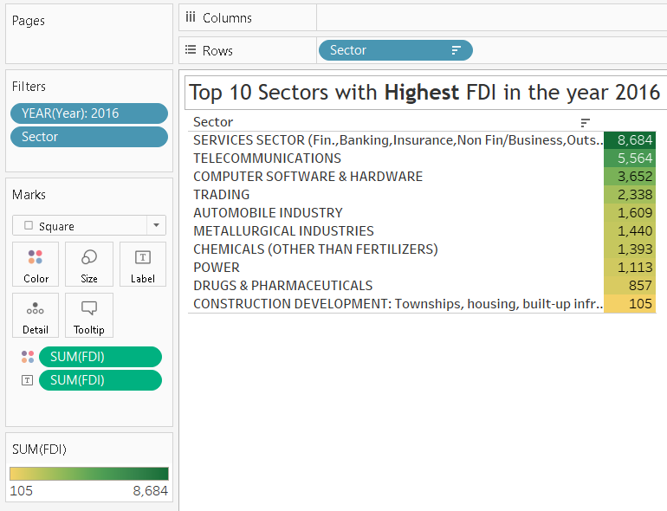
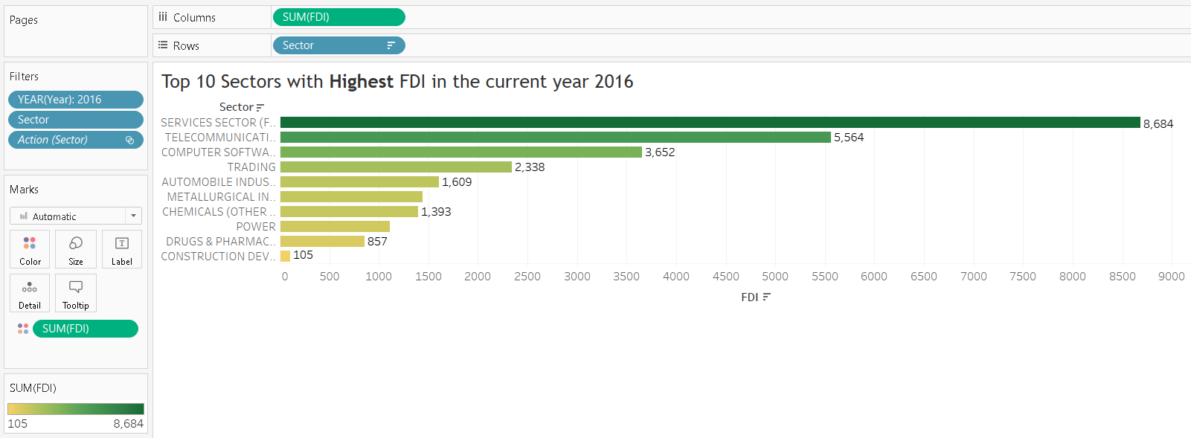
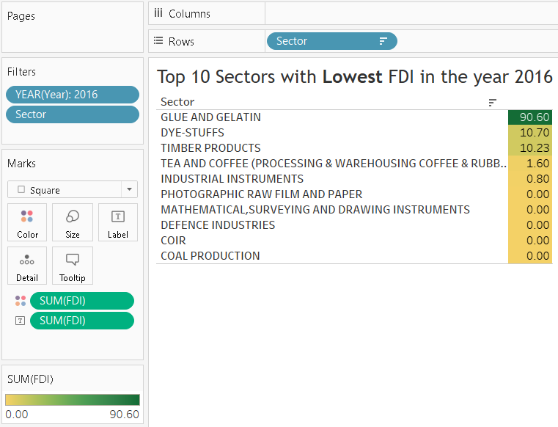
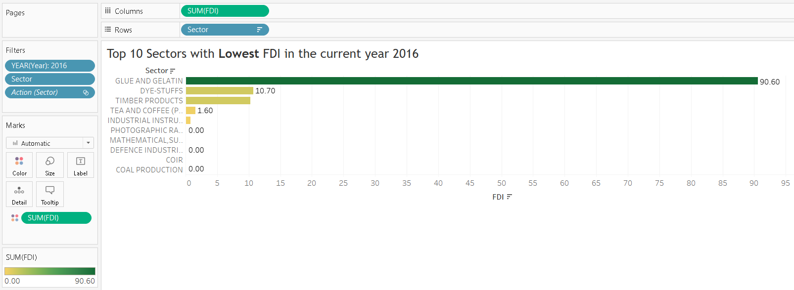
Dashboard Demographics 1

Slide 12
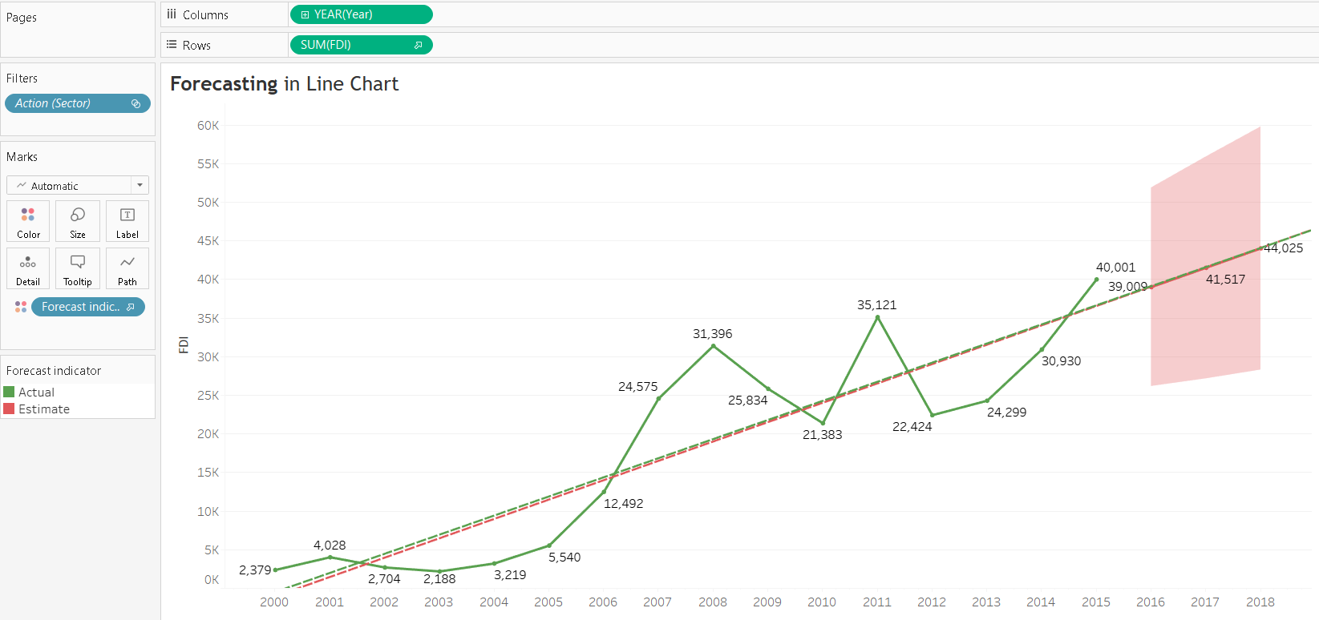
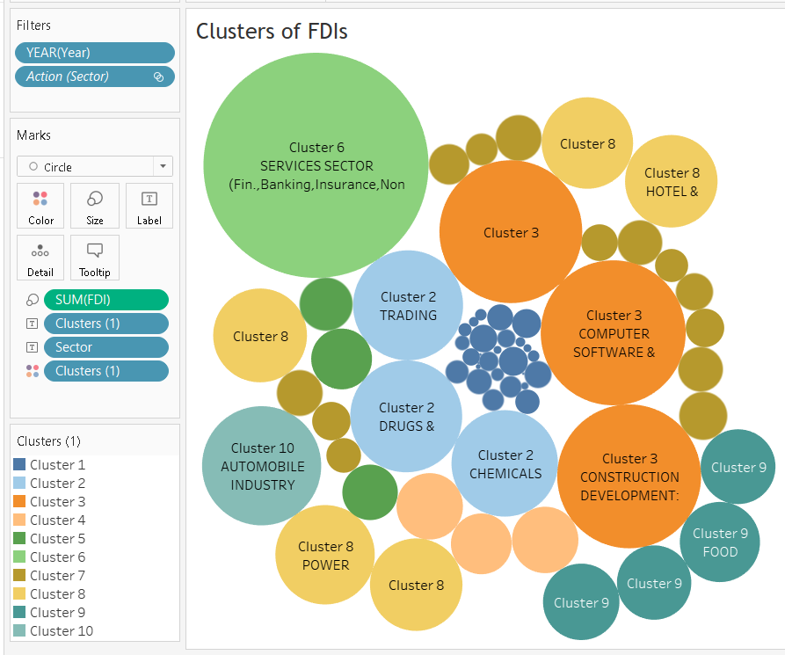
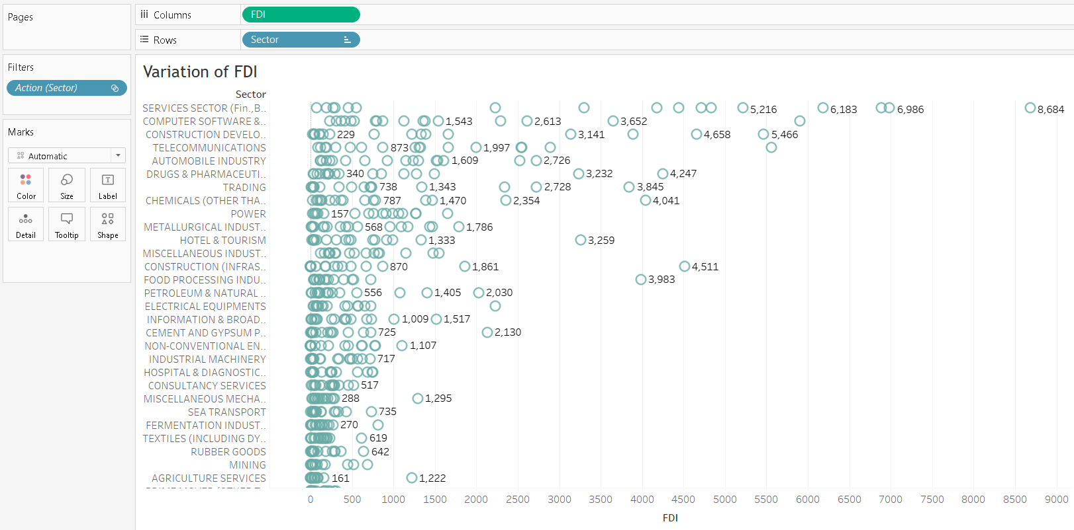
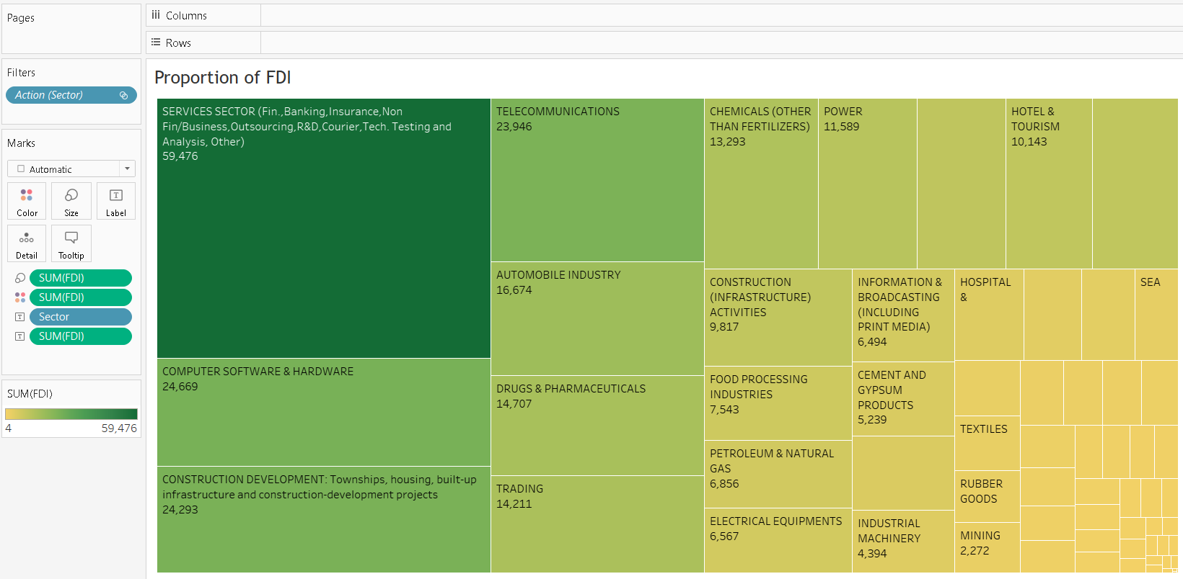
Dashboard Demographics 2

Slide 13
ARCHITECTURE DESIGN
THANK YOU
RISHI KALPA MUKHERJEE

